Slide 1
This deck contains videos for the RTVS documentation.

Slide 2
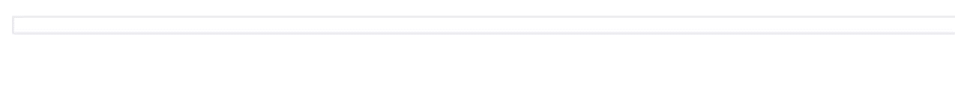
read.csv code snippet video

Slide 3
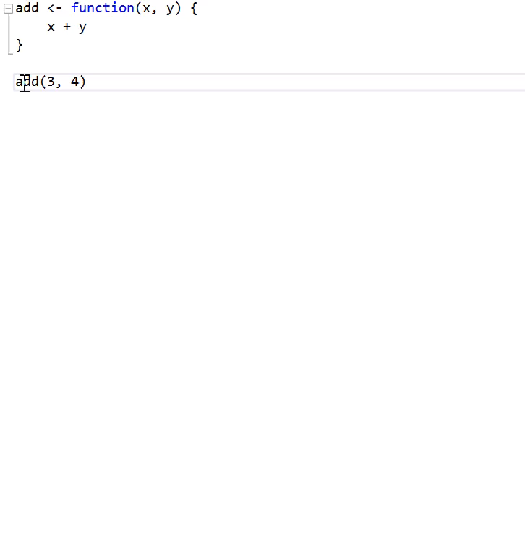
goto definition

Slide 4
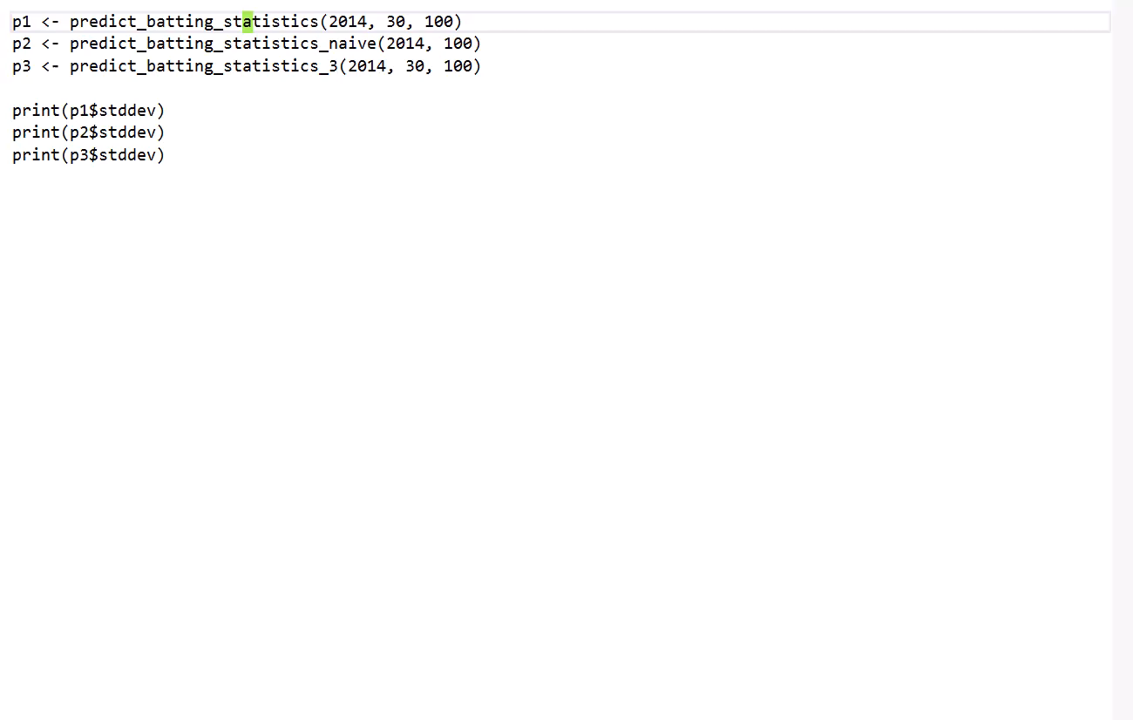
peek definition

Slide 5
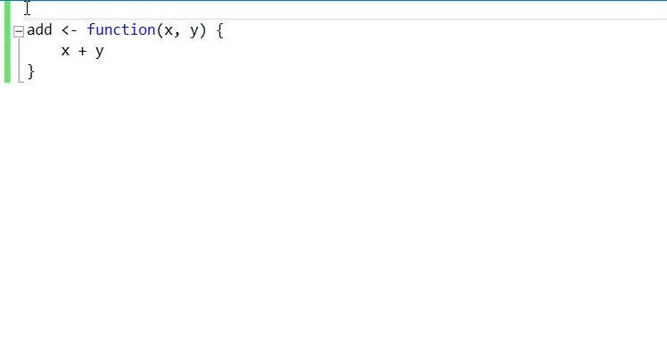
Roxygen comments

Slide 6
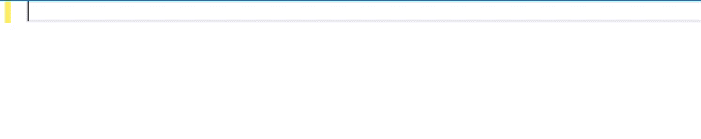
auto-format aligns on parameters

Slide 7
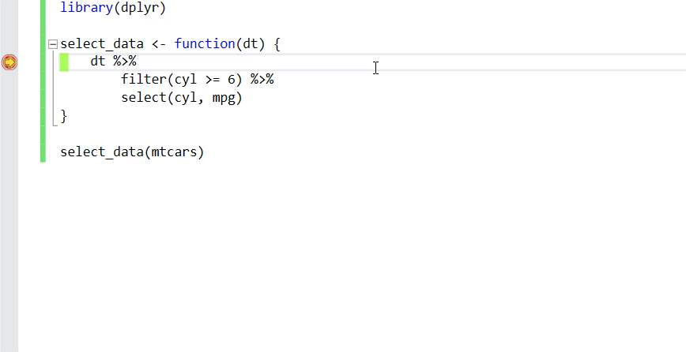
Debugger tooltips

